Slide 1
Ui ux design
Task
Presentation
By:
Piyusha Supe
UI UX Design

Slide 2
contents
1. Acknowledgement
2. Beginner level
3. Conclusion

Slide 3
Acknowledgement
I would like to express my gratitude to ShadowFox for giving me the opportunity to present the tasks I have completed during this internship.
I would also like to extend my thanks to my coordinator, Mr. Aakash, for guiding me throughout this experience. I acknowledge that the tasks were completed independently by me. Additionally, I utilized certain reference materials for research purposes for generating reference ideas.

Slide 4
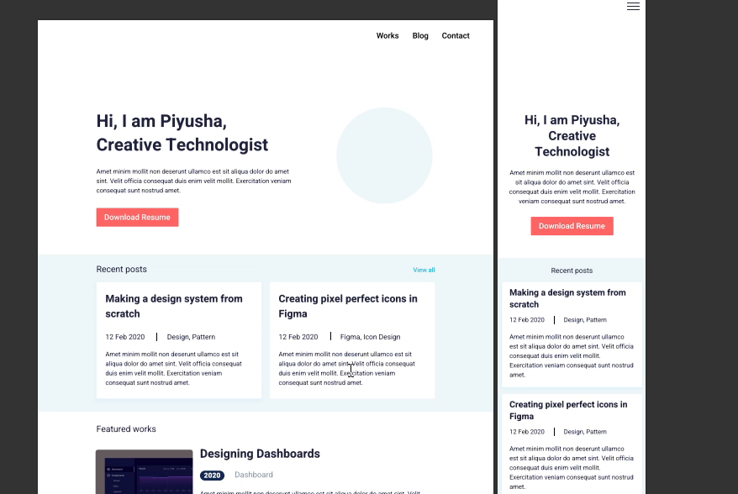
Beginner level

Slide 5
Conclusion
This internship provided valuable hands-on experience in the domain of UI UX Design. By completing the tasks outlined, I developed a strong understanding of tools like figma

Slide 6
Thank you

